Slide 1
Introduction to Insurance Score Service
January 2014

Slide 2
Insurance Score Service (ISS) : What is it?

Slide 3
Insurance Score Service is :
Redesigned Roxie scoring service.
Service can score using different models.
Design allows for multi-model scoring.
Decoupled architecture allows for separate component to be developed concurrently.

Slide 4
What is this architecture you speak of?

Slide 5
Insurance Score Service Framework
ISS Interface
Common interface
Account Validation
Routing
Output logs and results
Product
Data Validation
Calls data service
Assembles log Data
Create Attributes
Runs scoring
Data
Services
Calls external functions and services
Returns raw results
Typically devoid of business logic
Generates log information
Tools
Models
Continuous Integration
Code generators*
Audit*
Produce scores and reason codes
Exclusions and other business logic
Can keep a copy of attributes used for scoring
Produces information for logging

Slide 6
.. and how does it work?

Slide 7
Typical ISS process flow
Insurance Score Request
ISS Layer (NonFCRA/FCRA)
Product
Validate Account
Identify Model
Route to product handler
Validate request
Call Data Services
Create attributes
Execute model scoring
Assemble log data
Data Layer*
Insurance Score Context
Return ISS response
Output logging info
Models
*Data attribute services.
Not a database.
Nothing is persisted.
Insurance Score Response
Produce Score
Produce Reason Code
Logging Info

Slide 8
Interface Requirements
Request and Response in RiskXML Format.
Request and Response layouts are the same for FCRA and Non-FCRA.
Request contains the model to be used for scoring.
Insurance Context contains account, customer and information on active models.
Context can contain information needed to call other data services.
Response will contain service codes, score and reason codes.
Service may output logging data depending on product/model.

Slide 9
What external data services exist in ISS?

Slide 10
ISS External Data Services
CDIP Claims Discovery for Claims Data Fill
CDIP Carrier Discovery for Claims Data Fill
Boca 4 Public Records
LexID service
New services to be added
CLUE Auto
RMP Life Experience Pack
MVR
NCF

Slide 11
So.. which models use new ISS service right now?

Slide 12
Models in the ISS ecosystem
Active Models – Non FCRA
Housing Status Indicator (HSI1)
Life Conservation (L502)
Claim Data Fill - First Notice of Loss (CF01)
Coming in 2014!
Life Underwriting Classification – FCRA (L503, L505, L507, L509)
Life Simplified Issue – FCRA (L504, L506, L508, L510)
Attract Commercial Driver – Non FCRA (C114, C115)
MVR Predictor Models – FCRA
CDF Attributes
LDW - FCRA (grandfathered from existing ISS)

Slide 13
ISS Logging data sets
LOG_log__mbsi_transaction__log
LOG_log__mbsi_transaction__log__extension
LOG_log__mbsi_intermediate__log
LOG_log__rmp_transaction__log
LOG_log__rmp_transaction__log__extension
LOG_log__rmp_intermediate__log
LOG_log__rmp_transaction__log__person
LOG_log__rmp_transaction__log__vin
In addition, the logs from data service function calls if they are being returned.
Logging may or may not be enabled based on product requirement.

Slide 14
I remember seeing a “Tools” layer..

Slide 15
ISS Toolset
Routines, codes and practices used for rapid development and testing of ISS components
Code Generators | Builds basic code from specifications
Audit Framework | Scripts used to generate audit materials
Continuous Integration | Runs automated tests on ISS components

Slide 16
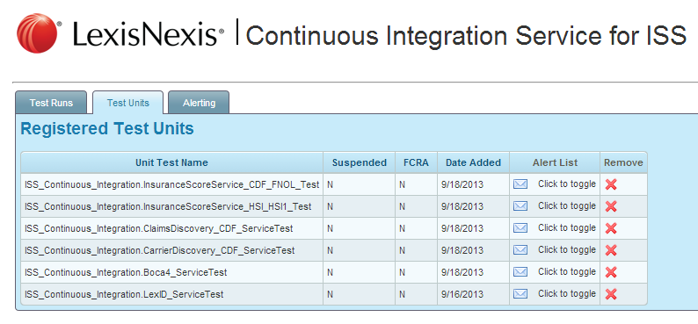
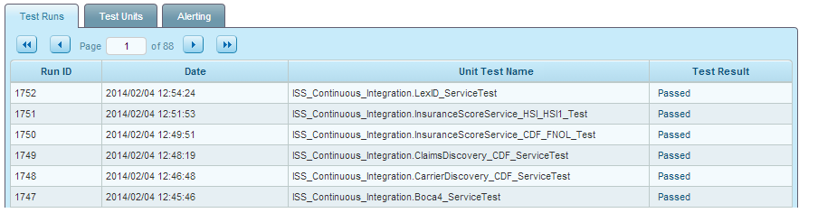
ISS Toolset

Slide 17
These bullet points look important. They are!
Service will only process one transaction per call.
Transaction is rejected if ISS cannot find an active account and, an active and known model for scoring.
Transaction is also rejected if request or context are empty.
Models unknown to ISS will be ignored.
There are Two ISS services: NonFCRA and FCRA. The name ISS in general refers to both. They use the same framework, services and tools but holds different sets of known models and products.
ISS can also receive extra data/attributes in the request instead in lieu of calling a data service internally.
Changes to the framework will require regression test in CERT of all ISS models.
Changes to the model may also require regression test in CERT of all the other models, although not necessary.

Slide 18
More bullet points
Adding a new model requires coordination with modelers and auditors to build test data, exclusion cases, score and reason code validation and generation of audit material. Fundamentally, this is the bulk of ISS work.
Adding new data services also impacts ISS development schedule depending on how the data can readily be retrieved and/or converted to attributes.
ISS only outputs the log information data. Another team performs the actual logging of the data to database tables.

Slide 19
Introduction to Insurance Score Service
Q & A

Slide 20
Technical Design
Yes!
It gets technical from this point.
(Brace yourselves for deluge of terms and acronyms)

Slide 21
ISS Design Philosophy
Each layer is responsible for its own data and behavior.
ISS layer is only concerned with account validation and routing.
Little or no business logic in data layers. It is up to the caller to transform the raw result into a format it can use.
Request and response layout are RiskXMLRequest and RiskXMLResponse respectively. Non-negotiable.
ISS is primarily used as a Scoring Engine. Any other proposed usage will require a design session or rejected outright.

Slide 22
ISS Layers - ECL Attributes at a glance
ISS_CORE | Includes the access points, common codes, layouts, constants and the MetaModel attribute used for model classification and routing.
ISS_EXTERNAL_DATA_SERVICES | Contains all data service attributes.
ISS_MODELS | Contains all the model attributes known to ISS. Note: Some models may reside outside of this folder, specially older, existing models being re-used from within the framework.
ISS_PRODUCTS_* | The product layers for different products. E.g. ATTRACT, CDF, HSI, etc.
ISS_CONTINUOS_INTEGRATION | Contains the test scripts that are executed by the CI server at scheduled times.

Slide 23
Interface Layouts
Layout Names | ECL Attribute
RiskXML Insurance Score Request | iesp.insurance_score.t_InsuranceScoreRequest
RiskXML Insurance Score Context | InsuranceContext_iesp.insurance_risk_context.t_InsuranceScoreContext
RiskXML Insurance Score Response | iesp.insurance_score.t_InsuranceScoreResponse
Service Names
ISS_CORE.Service_ISS | ISS NonFCRA Service Name
ISS_CORE.Service_ISS_FCRA | ISS FCRA Version Service Name
Using common interfaces allows parallel development of ISS and the
calling products

Slide 24
ISS_CORE.MetaModel
Attribute contains all the model and product mappings. Contains both FCRA and
NonFCRA models.
…
EXPORT AllProducts := DATASET([
{Products.CDF , 'Claims Data Fill',[Models.CF01]},
{Products.HSI , 'Home Status Indicator 1',[Models.HSI1]},
{Products.LDW , 'LDW 1',[Models.LDW1]},
{Products.LIFE , 'Life',[Models.L502]},
{Products.LIFE_FCRA , 'Life FCRA',[Models.L503,Models.L504]},
{Products.ATTRACT, 'Attract Commercial',[Models.C114, Models.C115]}
], ProductTable_Layout);
…
Note: A model can only be assigned to one product.

Slide 25
ISS_CORE Common, Layouts and Utils
All common code, functions and layouts that can be used in any layer of the
framework should be contained here. Other layers can override the codes or
layouts here with their own implementation.
Common utils provide basic transforms and convenience functions not readily
provided by the ECL language, standard library or ut attributes. If a function already
exists elsewhere, it is best to use that function rather than adding a new one for ISS.

Slide 26
ISS_EXTERNAL_DATA_SERVICES
Contains all the data service attributes. Data services can be a function call to another attribute, a key-file join, or a SOAP call to an external service. It can also be a record/dataset passed in from the request.
There is no fixed interface requirement for the data service other than passing in the request and context and a test flag.
The following attributes need to be returned/exported:
EXPORT results := // result dataset or record to be returned
EXPORT CompletionCode // 0 for Completed. Anything else for different error condition
EXPORT ServiceRequestIntermediateLog //When applicable, the log data for the service request
EXPORT ServiceResponseIntermediateLog //When applicable, the log data for the service response
Other attributes can also exported when needed. E.g. result count or extra logs.

Slide 27
ISS_MODELS
All native models known to ISS should be placed here. The interface to the model is a layout of attributes required by the model. This can be a simple name-value pair layout or a composite ECL record layout. Additionally, the request and context can also be passed in but is not really required.
The models should export these two attributes:
EXPORT model_result := // contains scores and reason codes
EXPORT ProductModelResult // Contains the model_result, along with product/model information and
// list of attributes
The model should also be able to keep a NVP list of all the attributes and their values, scores and reason codes used in the scoring.

Slide 28
ISS_PRODUCTS_*
Each product will have its own folder in the repository. Products work on a set of related models and the layer will have its own attribute to contain layouts, validation routines, constants and common functions used by that product layer.
The product layer is responsible for calling the external data services and transforming the results to attributes that can be fed to the models. The product layer also performs additional validation on the request and the models. Finally, the product layer is responsible for executing the models to generate the scores and reason codes. The product layer does not concern itself on how the models generate the score. Only that it expects the models to return a result.

Slide 29
ISS_PRODUCTS_*
The important attributes in this layer are as follows:
Common – Common functions and routines
Constants
executeModels – calls each model and extract score results
Layouts
Validation – Routines that determine if scoring can proceed
The product layer requires the request and context to be passed in and also a test flag.
EXPORT response := // contains the RiskXML Score response and also the different logging datasets.

Slide 30
ISS_Continuous_Integration
This layer contains the test cases that are executed manually, or through the automated Munson test framework. For automated testing, the structure is as follows:
EXPORT <module_name> := MODULE
EXPORT RUN() := FUNCTION
//add test routines here
// Add ASSERTs here
RETURN 'PASSED'; //This is the only return value allowed. Any failures should be caught by ASSERT
END;
END;
.

Slide 31
Account And Model Validation
ISS will look at the account and model status in the Insurance Context for validation.
A status of ‘A’ for the account or model indicates that the account or model is active and can be used.
Account Validation
Account.Status = ‘A’ and Account.Legacy.Base <> ‘’
<Account>
<MBSId/> <Name>LN_ISS_ACCT </Name>
<DisplayName/> <AccountType/> <CompanyId/>
<Status>A</Status>
<AddressLine1/><AddressLine2/>
<City/><State/><Zip/><Zip4/>
<Legacy><Base>
</Base><Suffix> </Suffix><
</Legacy>
</Account>

Slide 32
Account And Model Validation
Model Validation
Products.ISS.ScoreModels.ScoreModel.Status = ‘A’ and
Products.ISS.ScoreModels.ScoreModel.ModelID <> ‘’ and
Products.ISS.ScoreModels.ScoreModel.ModelID in
request.ProductOptions.InsuranceScore.Options.Models.model.name
<Products><ISS>
<CustomerName/><CustomerNumber/>
<Status>A</Status>
<CCFCAllowed/><CDSCAllowed/>
<ScoreModels><ScoreModel>
<ModelId>L502</ModelId>
<Status>A</Status>
<PurposeCode/><AttributeNames/>
</ScoreModel></ScoreModels>
</ISS></Products>

Slide 33
ISS_CORE.MetaModel
Contains the mapping between products and models attached to the product. A models can be associated only with one product. This attribute is used by ISS to identify which product will handle the scoring based on the model coming in from the request. If ISS cannot identify the model or the product from the model, an ‘Invalid Data: Unknown Model’ error is returned.
EXPORT AllProducts := DATASET([
{Products.CDF , 'Claims Data Fill',[Models.CF01]},
{Products.HSI , 'Home Status Indicator 1',[Models.HSI1]},
{Products.LDW , 'LDW 1',[Models.LDW1]},
{Products.LIFE , 'Life',[Models.L502]},
{Products.LIFE_FCRA , 'Life FCRA',[Models.L503,Models.L504]},
{Products.ATTRACT, 'Attract Commercial',[Models.C114, Models.C115]}
], ProductTable_Layout);

Slide 34
Technical Design
Q & A

